Slide 1
AUTOMATIC METER READING SYSTEM

Slide 2
Contents
Issues with stand alone metering
Smart Metering and IT: An opportunity to Leapfrog
Critical Benefits from AMRS
Definition
AMR network architecture
  GSM Based Communication
  PLCC based Communication
  Network Architecture/Hybrid Communication
Primary components
PLCC / GSM Modem
Inbound Outbound Dialing
Advantages

Slide 3
Issues with Stand-alone meter reading
Highly Person dependant.
Human errors cannot be avoided.
Accessibility of meters in rural/ Agricultural zones.
Energy Audits performed based on bill collection which is highly inaccurate.
Billing done mainly on estimated/ monthly average basis
Inability to monitor and control discrete loads
Billing cycle requires excessive time.
Meter data used only for billing, cannot help in analysis like demand analysis, energy audit, pinpointing losses, etc.

Slide 4
Smart Metering and IT: An opportunity to Leapfrog
ELECTRO-MECHANICAL
Low Accuracy
Control – NIL
Communications - Expensive
Theft Detection – Poor
PAST
DIGITAL SOLID STATE
High Accuracy
Control – LIMITED
Communications – External through Retrofit
Theft Detection – Node only
CURRENT
NEXT GEN SMART METER & IT SYSTEM
Very High Accuracy
Control – FULL
Communications – Built in (on chip / PCB)
Theft Detection – High (Network level)
LEAPFROG

Slide 5
Critical Benefits from AMRS
Ability to detect tamper events and outage occurrences.
Remotely Connect/ Dis-connect power supply through meter.
Calculate transformer loading and sizing from interval data
15 minute interval data gives accurate load information for supply scheduling, switching operations, planning etc
Monitor voltage at each premise to know conditions when to operate capacitor switches or regulators
Consistent and granular data for improved accuracy

Slide 6
Definition
AMR
  Automatic Remote Meter Reading .
  Automating the process of measurement through digital communication techniques.
  Bring “intelligence” into the revenue cycle and manage it:
Metering Billing Operations Customer Service

Slide 7
Automatic Metering
Automatic
Meter
Reading
Pre-payment
Outage Management
Automatic Metering
Active Load Control
Sub-Metering
Revenue Protection

Slide 8
AMR NETWORK ARCHITECTURE

Slide 9
Connectivity in AMR Architecture
1. GSM Based Communication
Single stage communication between Meter and central station through GSM Modem
2. Hybrid Communication
Two stages of communication in AMR System

Slide 10
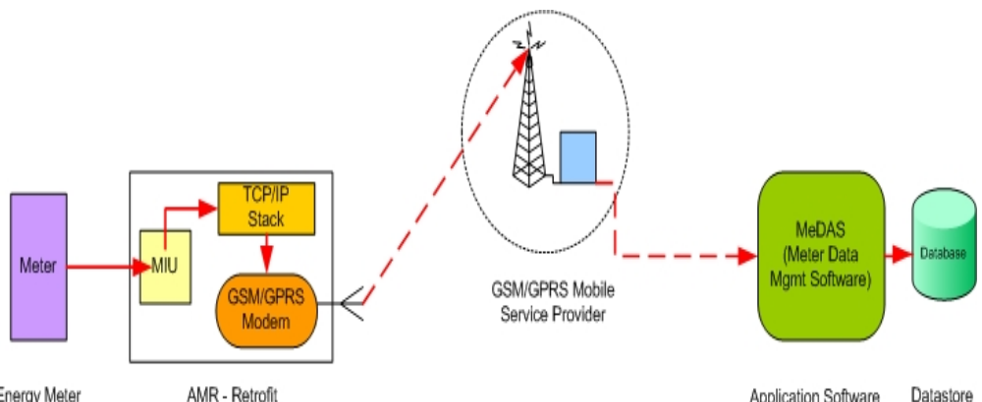
GSM Based Communication

Slide 11
Hybrid Communication
Two stages of communication in AMR System
  Meters and Data Concentrator Unit (DCU): Communication channel used between meters and DCU is Power Line.
  DCU and Host Central Station (HCS): Communication channel used between DCU and HCS is the standard GSM, CDMA, RF or PSTN Network.

Slide 12
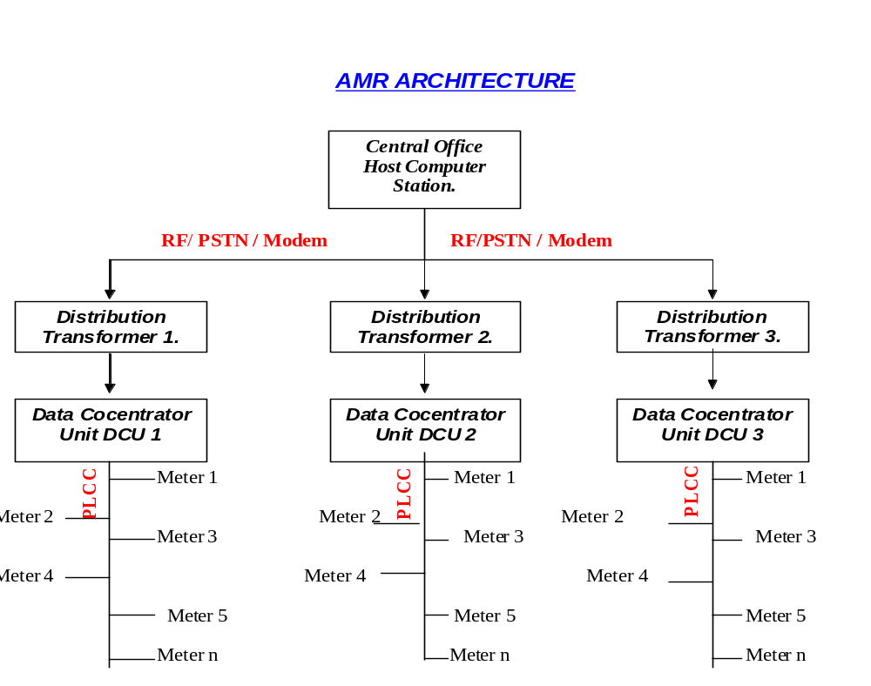

Slide 13
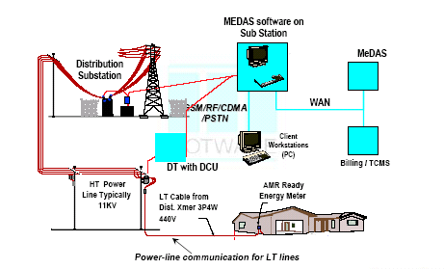
Network Architecture/Hybrid Communication

Slide 14
PRIMARY COMPONENTS:
Meter Interface Module
Communication System
Central Office Equipment

Slide 15
Meter interface module
  The AMR system starts at the meter. Some means of translating readings from rotating meter dials, or cyclometer style meter dials, into digital form is necessary in order to send digital metering data from the customer site to a central point.
  Electro - optical interface
  Signal Processing Electronics
  RAM & Program Memory

Slide 16
A. GSM Based Communication
GSM modem
Antenna

Slide 17
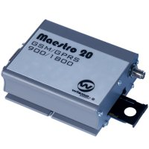
GSM Modem
Dual Band or Triband GSM GPRS modem (EGSM 900/1800MHz) / (EGSM 900/1800 / 1900 MHz )
Designed for GPRS, data, fax, SMS and voice applications
Fully compliant with ETSI GSM Phase 2+ specifications (Normal MS)
Interfaces
RS-232 through D-TYPE 9 pin connector
Power supply through Molex 4 pin connector
SMA antenna connector
Toggle spring SIM holder
Red LED Power on
Green LED status of GSM / GPRS module

Slide 18
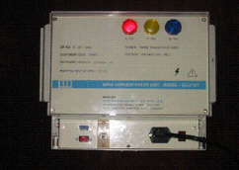
Data Concentrator Unit (DCU)
B. PLCC Communication
The Data Concentrator sits on the loop of secondary of the distribution transformer. Collects meter readings from all the meters using Power Line Communication System at predefined intervals.
The DCU and all the meters connected to it can be considered as a sub-system of the HCS. The sub-system is set up with a DCU monitoring the low voltage power zone downstream of a Distribution Transformer.

Slide 19
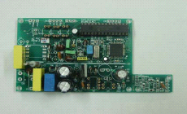
Retrofit Card
Consists of a single PCB, which converts CF pulses of Electronic Energy Meters to Electrical pulses, accumulate them and generate a meter reading with help of Microprocessor.
Microprocessor converts this data into Power Line Modulation.
Existing Meter Reading, Meter Constant and Meter ID is stored in NV RAM of Micro controller, before Retrofit is made operational.
One unit is incremented when Retrofit senses the pulses equal to Meter constant.
The incremented unit are stored in the NV RAM of the Micro controller.

Slide 20
PLCC Communication

Slide 21
Power Line Carrier Communications
Most economically viable technology for transferring Meter data to DCU.
Uses the technique of communicating the data over existing Electrical Lines which carry LT power to the site.
Employs an ASIC, which accepts digital data & converts it into FSK modulation and transmits it over the power line by sensing a zero crossing of 220V sine wave.
Typical frequency used for frequency modulation is 132KHz.

Slide 22
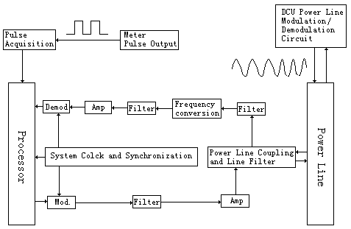
PLC Schematics

Slide 23
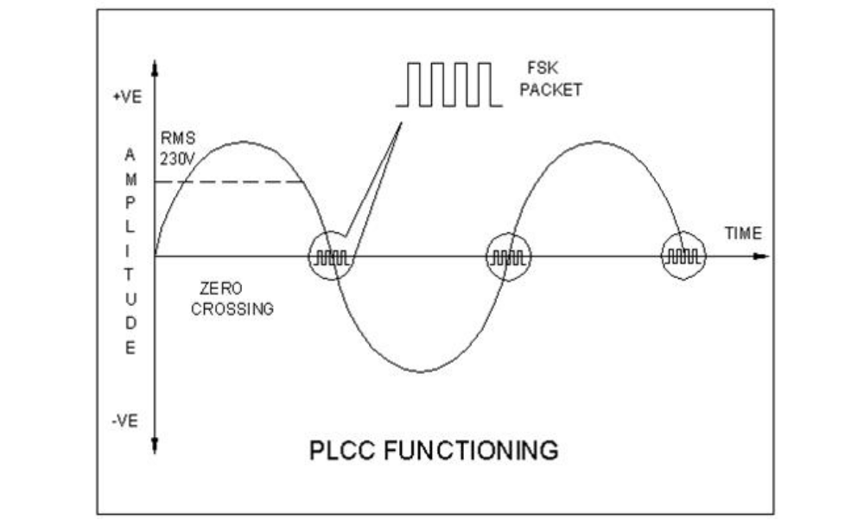

Slide 24
C. AMR Enabled Meters
Collect, process and record power consumption data and transfer it to DCU over existing Power Lines.
Monitor electrical load in real time.
After receiving a set of commands from DCU, meter process energy consumption data according to pre-set time intervals.
Data received from different meters are stored in corresponding Load Data Records in Flash memory of DCU.
The MIU is built-in, no separate Interface Unit is required.

Slide 25
Communications systems
  Used for the transmission, or telemetry, of data and control send signals between the meter interface units and the central office.
    GSM Network
    Power Line

Slide 26
GSM Network In AMR
Utilizing an existing cellular network for data transportation requires no additional equipment or software, resulting in a significant savings in both time and capital.
Cellular technology utilizes an encryption technique to prevent an outside source from receiving the transmitted data.
The cellular network provides full two-way communications, allowing scheduled reads, demand reads, alarm and event reporting, power outage reporting and power restoration reporting.

Slide 27
Why Power Line / Hybrid Communication?
PLCC Best Suited for LT 440 V network for detecting outages, tamper events and performing remote disconnect
Uses same power lines as communication media, so ideally suited for rural/ agricultural connections
Communication on HT side can be implemented via a choice of GSM, CDMA, RF or PSTN

Slide 28
Central office systems
Central office systems equipment includes:
  Modems
  Central server
  Client Software for data acquisition and data analysis

Slide 29
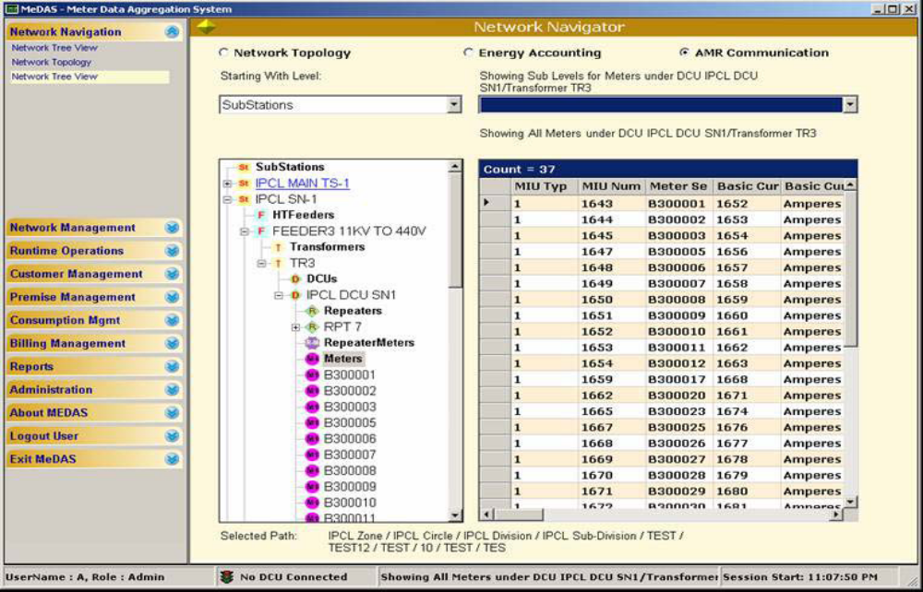
MeDAS
Software for AMR network management;
Data aggregation, Analysis & Energy Accounting

Slide 30
Meter Data Analysis & Energy Accounting
Network Schematic Modelling: Modelling the physical network structure (substation, HT Feeder, Transformer, LT Feeder) & keeping it updated as changes occur.
Handle Feeder Switching scenarios for Energy Accounting:
  From One LT feeder to another on the same transformer
  From One distribution Transformer to another distribution transformer, but with the same LT feeder
  From One HT feeder to another HT feeder but through the same DT and LT feeder

Slide 31
- contd.
Reports/Analysis
  Identifying customers with tampered meters or zero readings.
  Monitoring the energy consumed /supplied and energy accounts /reconciliation over a particular duration
    by customer category
    by network device (LT Feeder, transformer, HT Feeder, Substation)
    by geographical area (zone, circle, division, subdivision)
  Monitoring the maximum demand, voltage levels, current, power consumption/ load on each meter.
Can calculate Max demand of LT / HT feeder, Transformer & Substation
  Abnormal consumption report
  Ability to build ad-hoc reports without having to know any programming language or query language.
    Energy Balance Report
    Areas of High Loss Report
    Consumption trends Report

Slide 32
AMR FEATURES/ FUNCTIONS

Slide 33
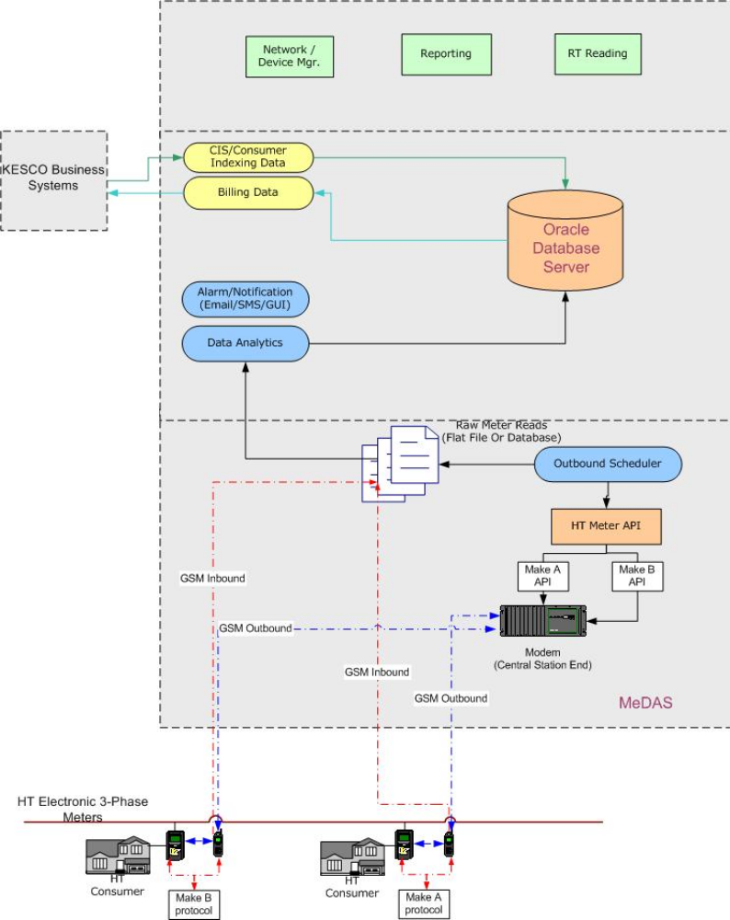
Inbound and Outbound Dialing

Slide 34
Inbound and Outbound Dialing -contd.
    This supports both outbound and inbound communication modes. In the latter mode, the modem passes the commands sent by the data acquisition server to the meter and directs the meter response as-is back to the server. The meter manufacturer specific APIs running on the server will send the necessary commands to collect the meter data.
    In the inbound mode, the modem will initiate communication to send reading or event data to the data acquisition server. It will again invoke manufacturer specific meter commands to collect data from the meter reading and tamper registers.

Slide 35
Inbound and Outbound Dialing -contd.
    This server comprises the following modules:
      Data Acquisition: The server holds the APIs for enabling outbound dialing to various makes of HT meters. MeDAS’ outbound scheduler schedules automatic dial out to respective meter-end modems.
      Data analytics:
        Raw reading/tamper data retrieved is first stored in flat files. This also applies to the data obtained from inbound dialing or downloaded from MRIs.
        The data analytics module then validates the raw data and stores it in the Oracle Database so that it can be used for further analysis.

Slide 36
Inbound and Outbound Dialing -contd.
Alarms and Notification: Sends notifications to the users via email/SMS/GUI for preprogrammed parameters like demand violation, abnormal power factor, tamper conditions, missing data and other preset conditions that the user might need alarms for.
Interfaces to existing KESCO systems to exchange consumer indexing information and billing data.

Slide 37
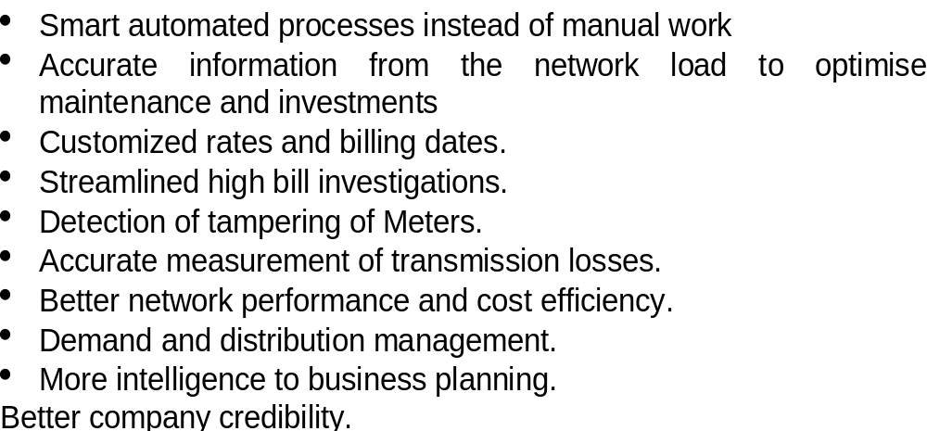
Advantages
ELECTRIC COMPANY BENEFITS

Slide 38
CUSTOMER BENEFITS
  • Precise consumption information
  • Clear and accurate billing
  • Automatic outage information and faster recovery
  • Better and faster customer service
  • Flag potential high consumption before customer gets a high bill.

Slide 39
Thank you

